Slide 1

Predicting the Tsunami Behavior from Historical Data
Nouha osama Alsaleh

Slide 2
Table of content
Problem statement
Dataset
tools
Data model
communication
resourses

Slide 3
Problem statement

Slide 4
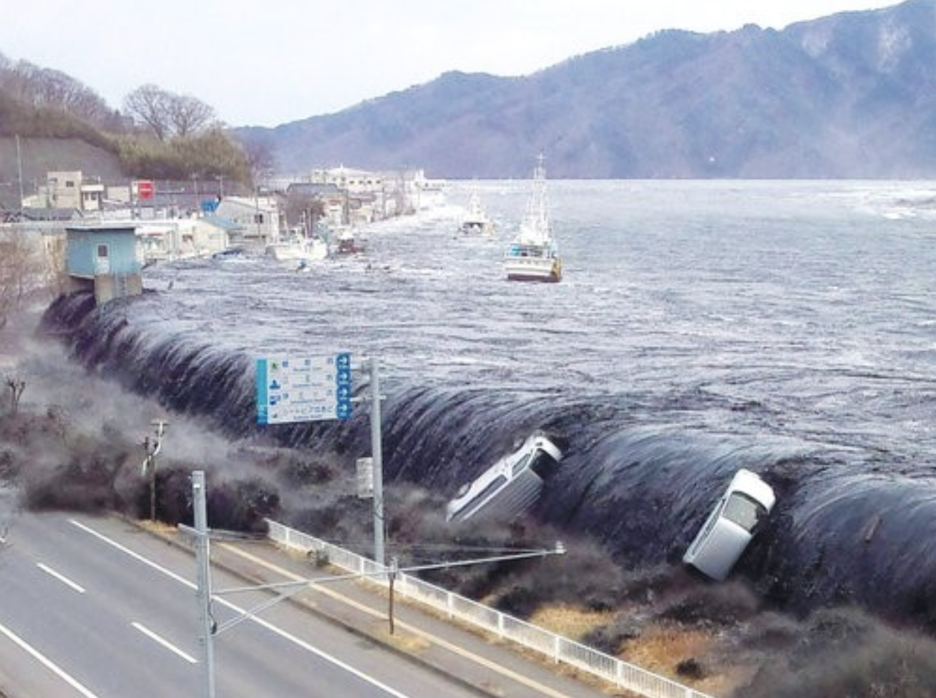
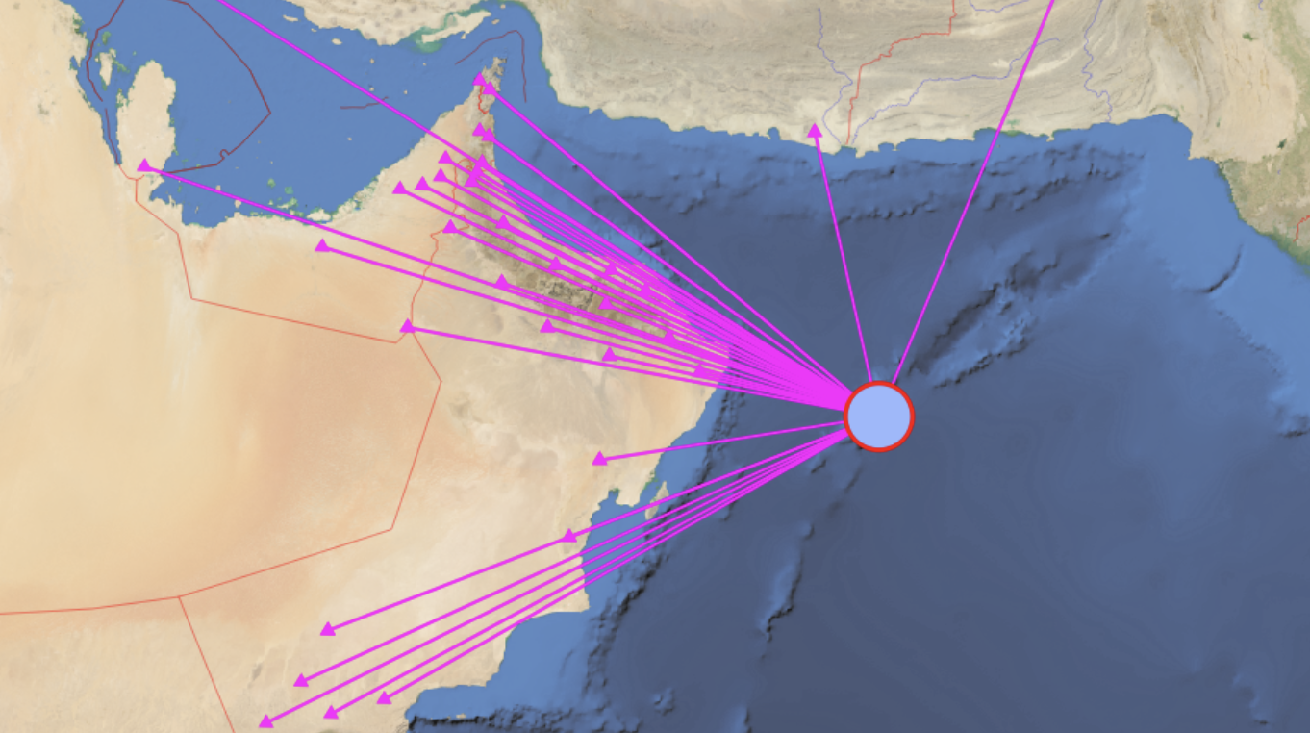
OMAN 2011

Slide 5
Data
Tsunami historical events data from (Homeland Infrastructure Foundation)
2100 BC – present
Data cleaning
Replacing empty fields with NAAN
Handle missing data
Remove entries before AD
26,824 rows (entry) and 105 columns

Slide 6
FEATURES
105
23

Slide 7
Findings

Slide 8
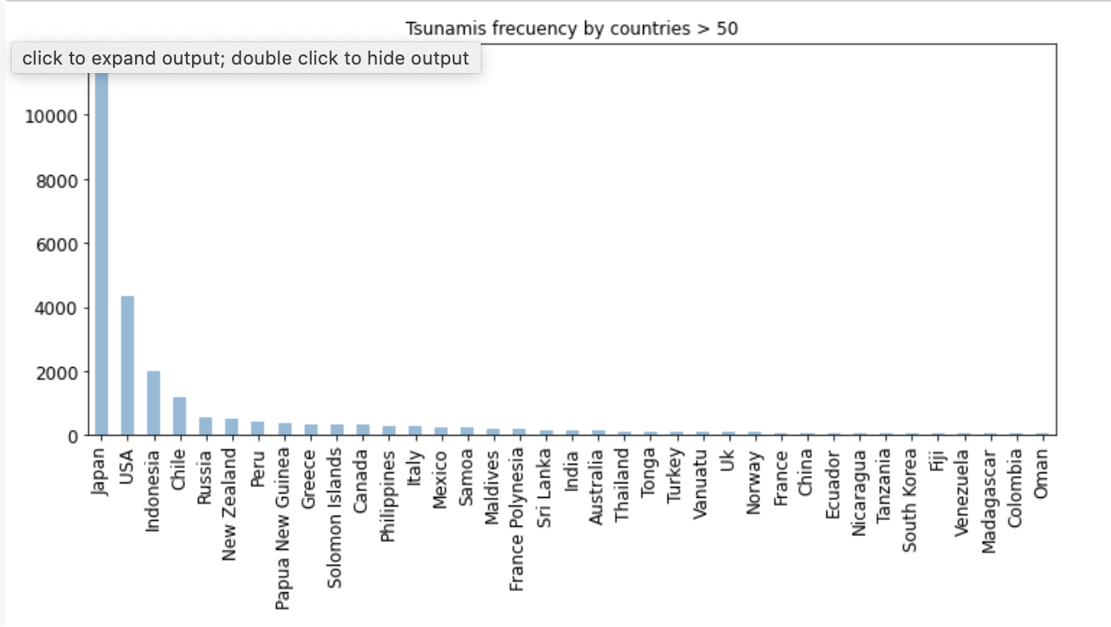
Higher tsunami frequincoes countries
1.Japan
2. USA
3. Indonisia

Slide 9
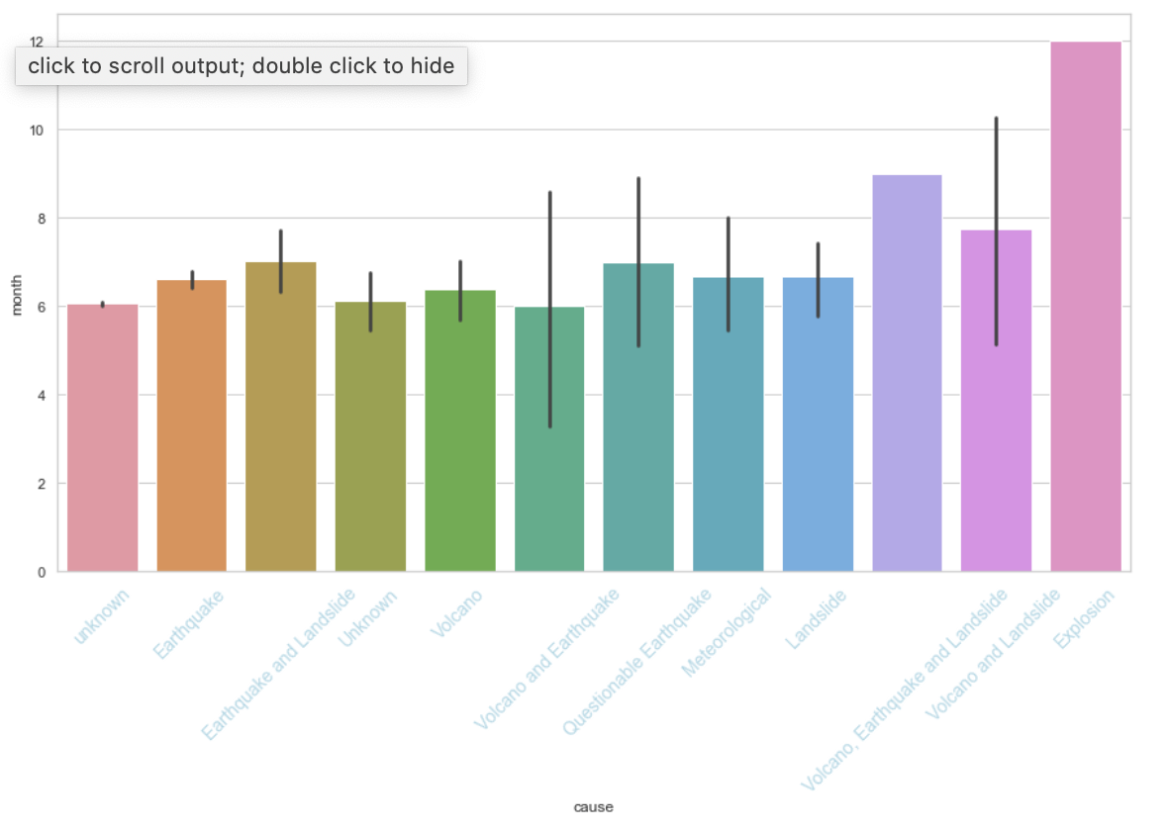
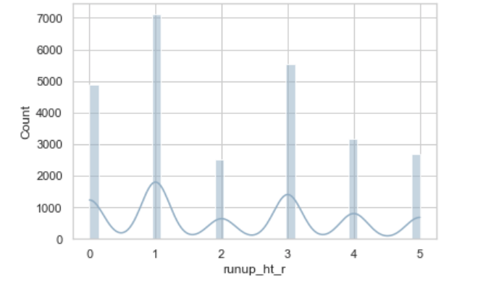
Explosions and earthquakes are the most effective triggers for tsunami
Peaks of tsunami is mostly 1 or 3

Slide 10
Algorithms

Slide 11
1. linear regression
 | MSE | MAE | R^2
Before feature engineering | 7.88e-15 | 1.14e-28 | 1.0
After feature engineering | 0.74 | 1.01 | 0.61

Slide 12
2. Sequential neural network

Slide 13
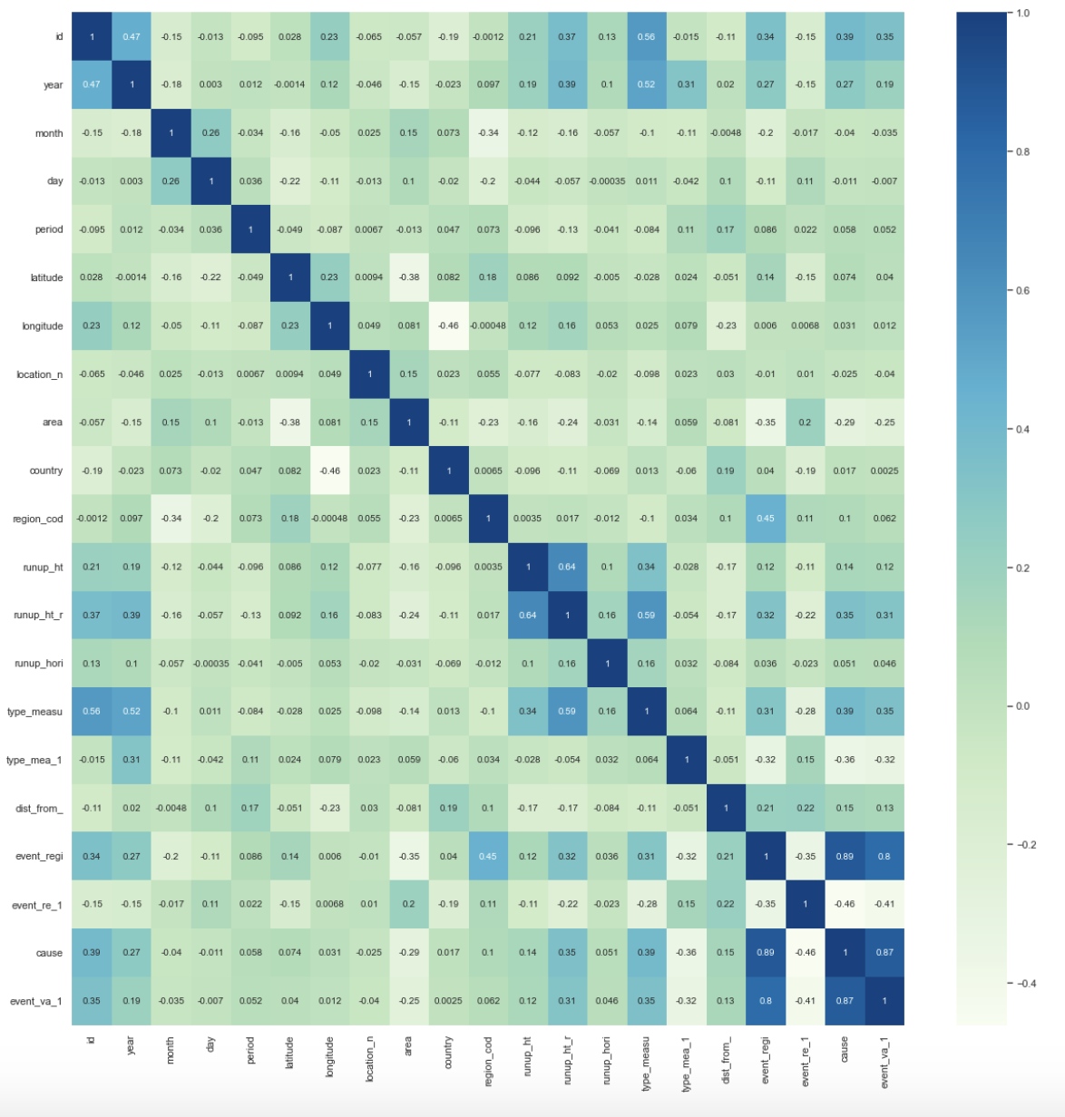
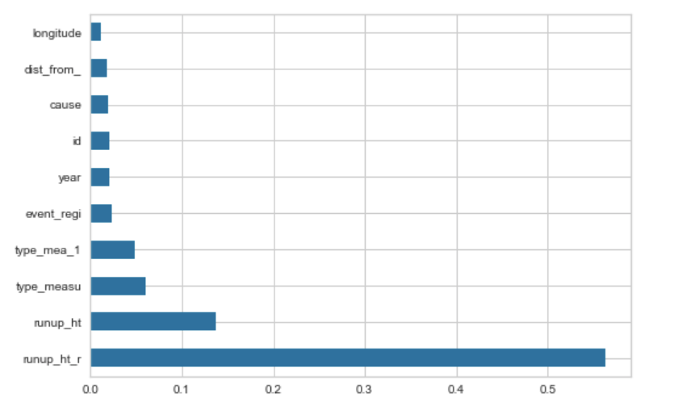
Feature engineering:
Top_corr_features
ExtraTreesClassifier

Slide 14



Tools
Data processing
Numpy
pandas
Visualization
Matplotlib
Seaborn
Modeling
Keras and
tensorflow
Scikit-learn

Slide 15
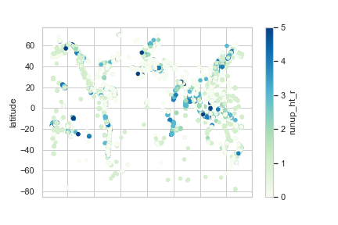
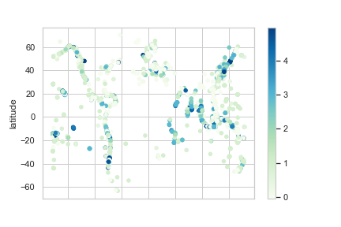
communication
original
predicted

Slide 16
recourses
https://data.world/dhs/historical-tsunami-event

Slide 17
Thank you any questions?

